Slide 1


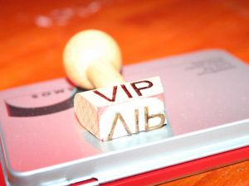


DESIGN A CONCEPT FOR A MAjOR EVENT OR FUNCTION
D1.HCA.CL3.02
Notes:
Trainer to introduce himself/herself to trainees.

Slide 2

Subject Elements
This unit comprises three Elements:
Identify key objectives of event
Establish concept, theme and format of event
Prepare a concept plan
Notes:
Trainer advises trainees that this Unit comprises two Elements, as listed on the slide explaining:
• Each Element comprises a number of Performance Criteria which will be identified throughout the class and explained in detail
• Trainees can obtain more detail from their Trainee Manual
• At times the course presents advice and information about various protocols but, where their workplace requirements differ to what is presented, the workplace practices and standards, as well as policies and procedures must be observed.

Slide 3

Assessment
Assessment for this unit may include:
Oral questions
Written questions
Work projects
Workplace observation of practical skills
Practical exercises
Formal report from supervisor
Notes:
Trainer advises that assessment for this Unit may take several forms all of which are aimed at verifying they have achieved competency for the Unit as required.
Trainer indicates the methods of assessment that will be applied to them for this Unit.

Slide 4
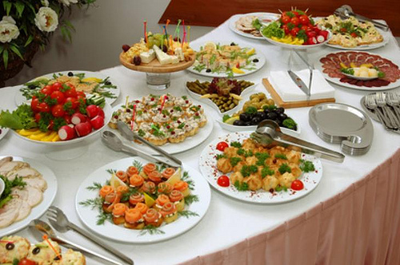
Element 1:
Identify key objectives of event
Notes:
Introduce topic.
Class Activity – General Discussion
Ask general questions:
What is the difference between events and functions?
What are examples of events?
Who normally arranges events?
What activities are common for events?

Slide 5

Identify key objectives of event
Performance Criteria for this Element are:
Clarify key objectives of event in consultation with customers and/or key stakeholders
Identify and analyse key information in consultation with customers and/or key stakeholders and other relevant parties
Identify and analyse factors which might impact on the event
Notes:
Trainer identifies the Performance Criteria for this Element, as listed on the slide.

Slide 6
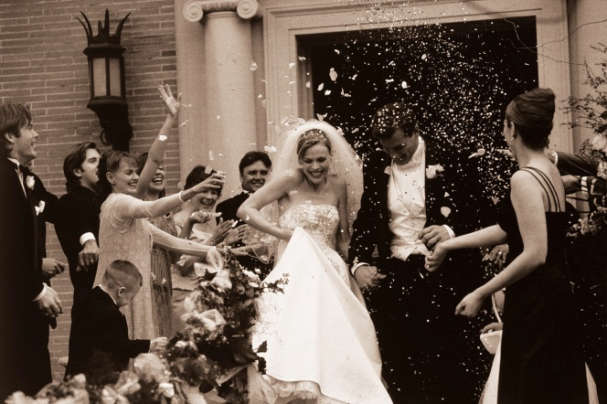
Events
What is an event?
What events have you been to in the past?
Notes:
Class Activity – General Discussion
Get audience to discuss the events that they have attended in the past.

Slide 7
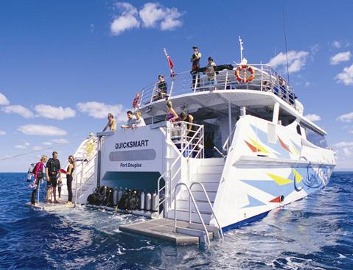
Events
Types of events
Homes for private functions
Meetings, banquets, conventions, and weddings
Nature areas including open water, zoos, parks, wineries
Transportation vehicles – including planes, yachts, cars, buses
Notes:
Class Activity – General Discussion
What needs to be arranged for these types of events?
Where are they normally held?

Slide 8

Events
Types of events
Festivals
Sporting events
Birthday parties
Anniversaries
Notes:
Class Activity – General Discussion
What needs to be arranged for these types of events?
Where are they normally held?

Slide 9
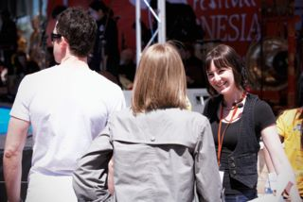
Benefits of events
For the customer:
It saves time and stress
It allows for professional staff to have the responsibility for running a event
It provides access to a specialist venue, room size and equipment
The outcome is a product or service which cannot be produced elsewhere
Notes:
Class Activity – General Discussion and Questions
Get audience to think about local hotels.
What do they provide which cannot be replicated at home or at an office?

Slide 10

Benefits of events
For a hospitality organisation
It is a major revenue source
It can appeal to a variety of market segments
It allows the organisation to promote itself by showcasing unique functions and events
It promotes creativity, skills and knowledge in staff
Notes:
Class Activity – General Discussion and Questions
Get the audience to think about the potential revenues generated through the following types of events.
How much revenue is generated through a normal meeting?
How much revenue is generated through a wedding?

Slide 11

Types of events
Breakfasts
Lunches
Dinners
Seminars, workshops and conferences
Cocktail parties
General parties, birthdays and celebrations
Weddings/receptions
Notes:
Class Activity – General Questions
What types of food and beverage are served at these?
What facilities mentioned before would be appropriate to hold these events?

Slide 12

Types of events
Anniversaries
21st birthday parties
Product launches and distributor functions
School formal, annual dinners and dinner dances
Annual general meetings
Training seminars
Graduations and award nights
Notes:
Class Activity – General Questions
What types of food and beverage are served at these?
What facilities mentioned before would be appropriate to hold these events?

Slide 13

Types of events
Press receptions
Fashion shows
Special events
Tradeshows
Stage productions, including music events
Notes:
Class Activity – General Questions
What types of food and beverage are served at these?
What facilities mentioned before would be appropriate to hold these events?

Slide 14

Types of events
MICE
Many venues focus on the MICE sector of the industry.
MICE stands for:
Meetings
Incentives
Conferences
Events
Notes:
Class Activity – General Questions
What types of events are associated with each category?
Why is the MICE sector very appealing to hotels as a key market to attract?

Slide 15

Types of events
MICE
Meetings include general business meetings
Incentives refers to functions that businesses organise to reward or motivate staff
Conferences are usually business/industry based occasions where people get together to discuss issues and share knowledge
Events can include bands, concerts, entertainments
Notes:
Class Activity – General Discussion
Discuss these points.

Slide 16

Event facilities
In most hotels there is a dedicated area for events, which can cater to a wide variety of activities comprising each event.
What areas/facilities can be used for events within a hotel?
Notes:
Class Activity – General Questions and List function facilities
Answer question in slide
Get audience to list all the facilities/spaces that can be used for an event.

Slide 17
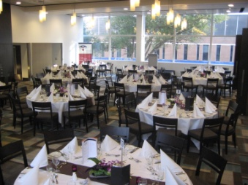
Event facilities
Range of facilities
Meeting/conference room
Stand up conference areas
Banquet room
Exhibition bays and space
Notes:
Class Activity – General Questions
What is each facility used for?

Slide 18

Event facilities
Range of facilities
Business centres
High-speed Internet access
Word processing
Photocopying
Faxing services
Computer access and rental
Faxing services
Notes:
Class Activity – General Questions
What costs are associated with each of these services?
The trainer may need to provide Business Centre Price list or audience to research.

Slide 19

Event facilities
Range of facilities
Business centres
Office supplies
Packaging and shipping
Secretarial services
Courier service
Translations
Arrangement of transport
Notes:
Class Activity – General Questions
What costs are associated with each of these services?
The trainer may need to provide Business Centre Price list or audience to research.

Slide 20
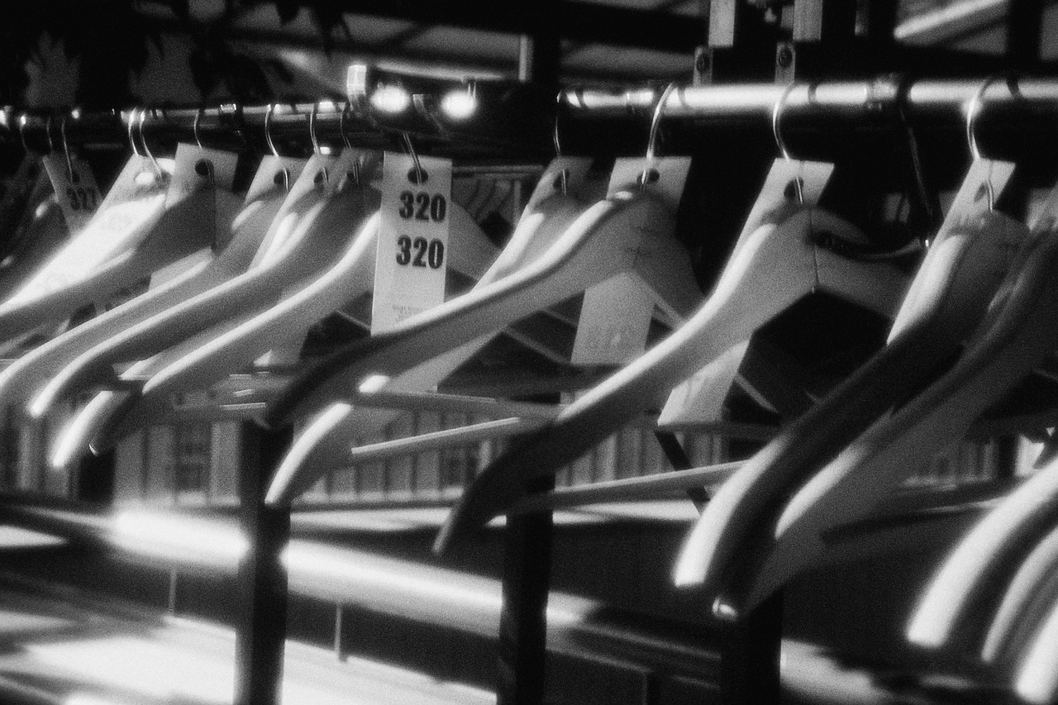
Event facilities
Range of facilities
Auditoriums
Press rooms
Storage bays
Parking facilities
Change rooms
Notes:
Class Activity – General Questions
What needs to be included in a facility for the press?
What different types of storage areas are needed and for what purpose?

Slide 21
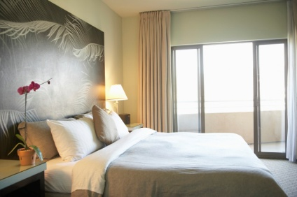
Event facilities
Range of facilities
Display areas
Designated and discreet sections of restaurants and/or bars
Food and beverage service
Accommodation
Notes:
Class Activity – General Questions
What are restaurant and bar areas used for?
What food and beverage services are provided?
What are accommodation rooms used for?

Slide 22
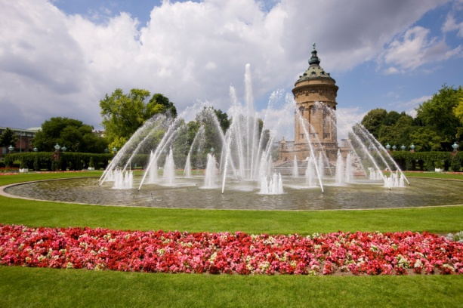
Event facilities
Range of facilities
Sound and lighting
Communication technologies and equipment
Music facilities
Gardens
Notes:
Class Activity – General Questions
What types of sound and lighting is available? What are they used for?
What technology is used in functions?
What equipment is used in functions?
What are gardens normally used for?

Slide 23

Receiving an enquiry
Information to collect
Contact person
Contact details
Type of event
Location
Date and time of event
Notes:
Class Activity – General Questions
How do people normally make an enquiry for an event?
What information do they need?

Slide 24
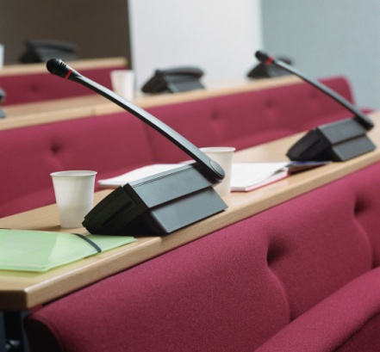
Receiving an enquiry
Information to collect
Budget
Possible number of attendees or guests
Overview of event requirements
Special instructions or requests
Notes:
Class Activity – General Questions
How do people normally make an enquiry for an event?
What information do they need?

Slide 25

Determine customer needs
Before any event or function can be organised there is a need to determine client needs for it
The most effective way to do this is to meet face to face with the client and talk to them about their needs, wants and preferences
Notes:
Class Activity – Questions
What is the purpose of an initial meeting?
What should be done or discussed in an initial meeting?

Slide 26

Meeting with clients
After receiving an enquiry and once initial information has been sent to clients regarding an event or function it is best practice to invite the client to your venue to
Talk to them about their expectations and needs
Allow them to view the property and its facilities
Meet some of the key staff, where appropriate
Notes:
Class Activity – General Questions
Why is meeting with clients important?
What do you want to achieve when meeting with clients?

Slide 27

Determine event objectives
Determine identified objectives for event of function
What different event objectives may an event organiser have?
Notes:
Class Activity – Discussion
Discuss the question in the slide.

Slide 28

Key stakeholders
Identification of key stakeholders
Event principal
Local community
Organising committees
Local authorities including police and fire
Internal event staff
External contractors
Entertainers
Talent
Staff from host businesses
Notes:
Class Activity – General Questions
What is the role of these stakeholders?

Slide 29

Lliaison and management structure
Event liaison and management structure
It is vital to confirm:
Event liaison
Management structure
Lines of authority
Notes:
Class Activity – Discuss the importance of these points
Event liaison – who are the contact people communications are directed to and who needs to be copied or involved in communication?
Management structure – who are key managers in relation to different aspects of an event?
Lines of authority - who are the ultimate decision makers or have overriding authority and responsibility?

Slide 30

Determine customer needs
Types of customer needs
A specific day and date
Style and format of function
Location
Timing and duration considerations
Food and beverage
Accommodation
Notes:
Class Activity – Discussion
Discuss points.

Slide 31

Event considerations
Entertainment
Specialist technology services
Equipment
Ancillary services and rooms
Guest numbers
Privacy
Budget
Notes:
Class Activity – Discussion
Discuss points.

Slide 32

Event considerations
Security
Themes and decorations
External providers
Notes:
Class Activity – Discussion
Discuss points.

Slide 33
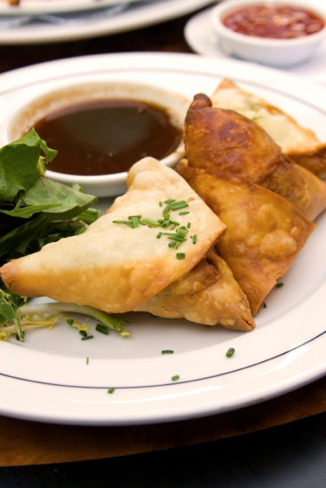
Function set up options
Stand-up function
This style of function is generally used for:
Cocktail parties
General parties
Lunches that are part of a conference
Notes:
Class Activity – General Questions
Discuss this set up option
What equipment items are required?

Slide 34
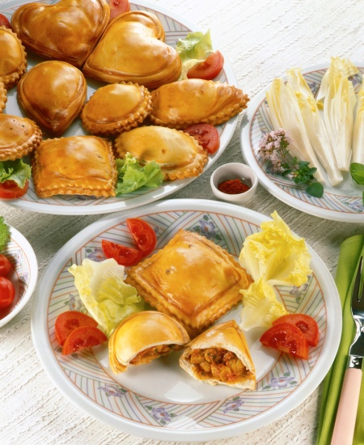
Event set up options
Stand-up function
The only seating might be around the edges of the room.
Several tables placed for:
Staff to place snacks
Guests to place drinks and any unwanted glassware, plates, food scraps
Notes:
Class Activity – General Questions
In what types of functions is this style of service popular?

Slide 35
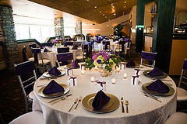
Event set up options
Sit down function
This style of function is generally used for:
Weddings
Formal dinners
Banquets
Presentations
Dinners for conferences
Notes:
Class Activity – General Questions
In what types of functions is this style of service popular?

Slide 36

Event set up options
Meetings
There are a number of styles to use when setting up a meeting
What set up options do you know?
Notes:
Class Activity – General Questions
Get the audience to answer the question in the slide.

Slide 37
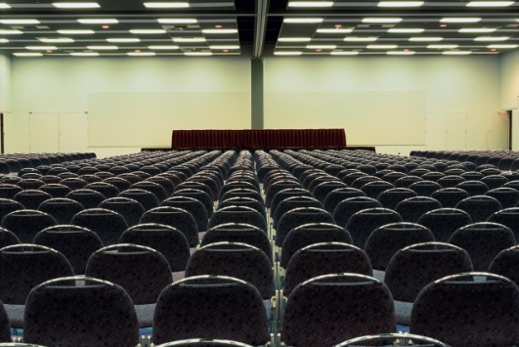
Event set up options
Meetings
Theatre style
Boardroom style
Hollow square
Classroom style
Banquet style
U Shape
E-shape
Notes:
Class Activity – General Questions
What are each of these set up options used for?
What are the benefits of each option?

Slide 38
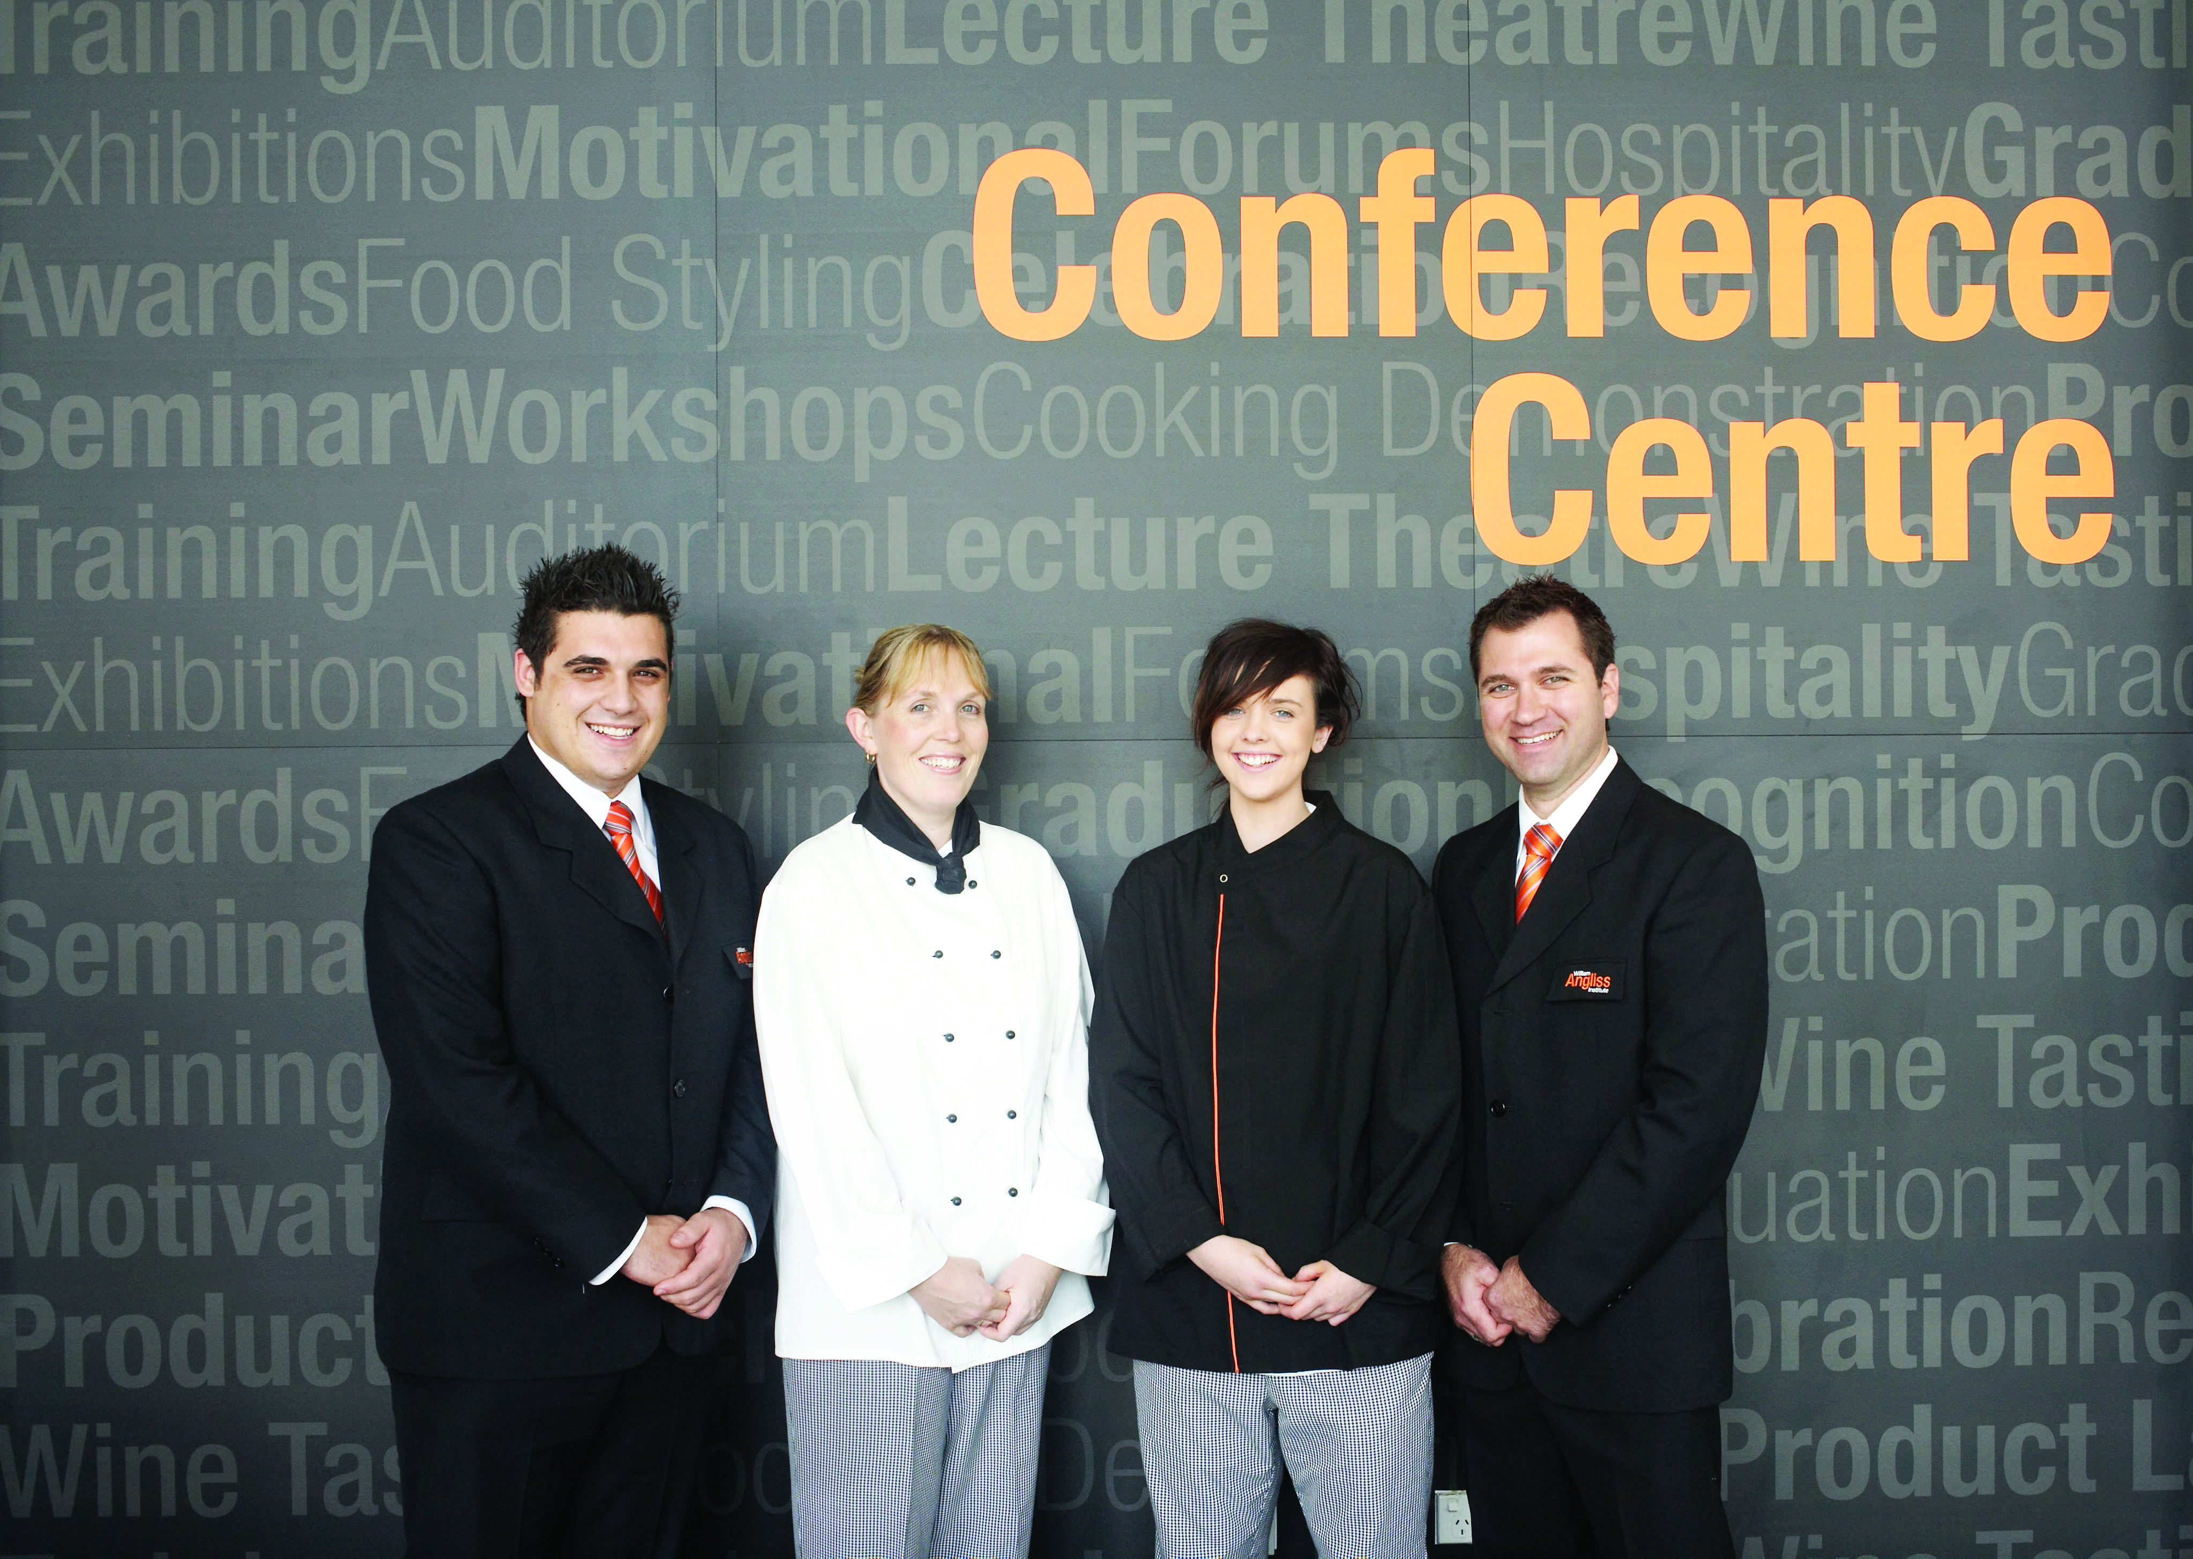
Identify options for events
Some clients have extensive experience with planning an event and many do not. Some clients will expect you to assist them in developing and planning their event, and others will not.
How do you identify if the client needs planning assistance?
Who can provide advice and suggestions?
Notes:
Class Activity – Discuss the questions in the slide

Slide 39

Arrange external services
Many individual functions traditionally may require the use of specialised skills or equipment which may not be available within the organisation
At these times, external services will be utilised
Notes:
Class Activity – Questions
What types of external businesses are utilised in functions?

Slide 40

Arrange external services
Types of external providers
Florists
Photographers
Party Hire companies
Entertainers
AV Technicians
Printers
Notes:
Class Activity – Questions
What specialist products or services do these businesses provide?

Slide 41

Arrange external services
Sourcing option
Like with any business, different companies will offer different products and services as a means of identifying their point of difference
It is a good idea to source at least three companies
Notes:
Class Activity – Questions
Where can you find information on different types of external suppliers?

Slide 42

Arrange external services
Liaising with providers to understand offering
Range of offering
Pricing structure for each item
Service guarantees
Availability
Prep-event services
Event services
Post-event services
Billing and payment arrangements
Notes:
Class Activity – Questions
What information would you like to know about external suppliers?
Range of offering – selection of products and services
Pricing structure for each item – including discounts or complimentary additional items
Service guarantees – what quality and quantity guarantees can they provide
Availability - how available are items. It is no use choosing a provider, no matter how cheap, if their items are never available
Prep-event services – delivery and setting up arrangements
Event services- what will the company do during the event to ensure its products or services operate as expected
Post-event services – take down and removal of items, cleaning etc
Billing and payment arrangements.

Slide 43
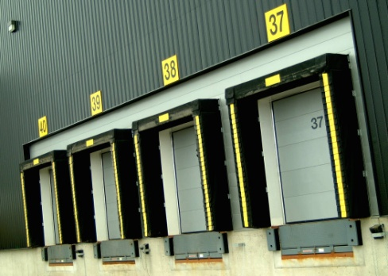
Arrange external services
Facilitating access by external providers
It is essential that providers understand:
What time they have access
Delivery and parking zones
Storage areas
Commencement and finishing times of the function
Amount of time allocated after the event for access
Notes:
Class Activity – Questions
Why is it important to discuss these points with external providers?
Trainer to provide examples of information that may be given to external suppliers in relation to each of these points.

Slide 44

Arrange external services
Connecting service providers with customer, where appropriate
In many cases functions staff will suggest that external providers correspond directly with the client because:
Functions staff do not have the technical knowledge or understanding
External providers can explain what they can offer and provide suggestions
Can remove a level of activity or responsibility from the functions department
Notes:
Class Activity – Discussion
Discuss points.

Slide 45

Factors impacting events
Identify and analyse factors which might impact on the event
Many requirements and needs of a client can be addressed without any influence or impact of other internal or external factors
At times there may be some factors that need to be identified and analysed to determine how they will impact on the ability to:
Hold an event
Conduct aspects of an event successfully
Notes:
Class activity – Discussion
What factors will impact on the holding on an event or parts of it?

Slide 46
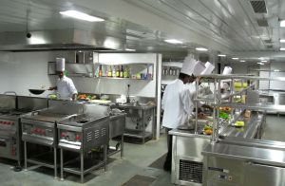
Resource availability
Types of resources
Resources can encompass:
Physical resources
Human resources
Financial resources
Intellectual property
Notes:
Class activity – Discussion
Provide examples of each type of resource.

Slide 47
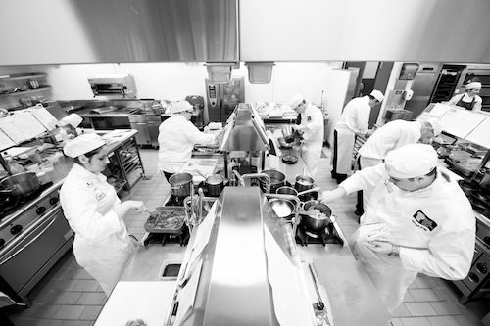
Resource availability
Common resources
Location/premises
Occupational health and safety (OHS) resources
Equipment
Raw materials
Stock and supplies
Technical equipment and software
Staffing
Notes:
Class activity – Discussion
Provide examples of each of these common resources.

Slide 48

Attracting additional resources
Potential for attracting additional resources
There are many resources that are required to conduct an event or function.
At times additional resources may be sought from different sources.
These sources of additional resources may come from:
Co-hosting
Sponsorship
Notes:
Class activity – Discussion
How can additional resources be gathered using these options?
What are the benefits of these options?

Slide 49
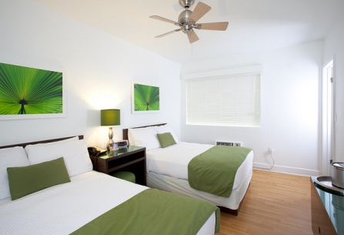
Co-hosting
Co-hosting avenues
It is not uncommon for a hospitality organisation to reach out to other companies to help host an event or provide aspects of it.
Hotels
Recruitment agencies
Suppliers
Exhibition Centres
Government agencies, industry associations etc.
Notes:
Class activity – Discussion
What resources can be gathered from each of these options?

Slide 50

Event sponsorship
Sponsorship is a common part of running an event
There are benefits for both the event organiser and the sponsoring business
Notes:
Class Activity – Questions
Why is event sponsorship common?
What are the benefits of sponsorship for both parties?
What types of sponsorship are there?
What do sponsors get for their investment?

Slide 51

Event sponsorship
Benefits for sponsors
Right to display and promote their name
Increase brand awareness
Affiliate with other organisations, charities or celebrities
Enhance the brand or visibility of an event by having a ‘reputable’ company behind it
Engage with the community and employees
Enhance product and service sampling
Improve contact and visual presence with the media
Notes:
Class Activity – Questions
What other benefits are there for sponsors?

Slide 52
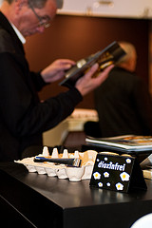
Event sponsorship
Identify potential sponsors
Potential sponsors can include:
Individuals
Government agencies
Companies
Industry organisations
Community groups
Notes:
Class Activity – Questions and Create list of sponsors for specific events
What other potential sponsors are there?
Think of a number of specific events and think of potential sponsors which you could attract.

Slide 53

Event sponsorship
Identify potential sponsors
A great starting point is to compile a list of suitable sponsors. This can include:
Current vendors
Past sponsors
Business partners
Affiliated businesses
Notes:
Class Activity – Questions
What are the benefits and advantages of starting with these companies?

Slide 54
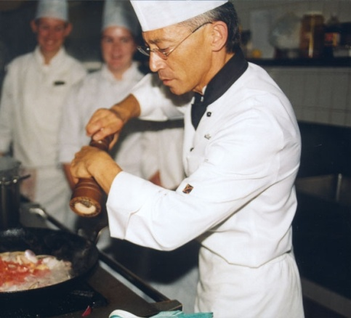
Event sponsorship
Types of sponsorship
There are a number of common types of sponsorship including:
Cash sponsorship
Product sponsorship
Venue sponsorship
Person sponsorship
Notes:
Class Activity – Questions
What are the advantages of these different types of sponsors?

Slide 55

Lead time restrictions
Timing considerations
Considerations when deciding to hold events with short notice include its ability to:
Provide sufficient amounts of meeting or event rooms
Provide sufficient amounts of accommodation rooms
Arrange staff to coordinate the event
Source sufficient food and beverage supplies
Source other resources
Notes:
Class Activity – Questions
What other considerations relating to timing need to be considered?

Slide 56
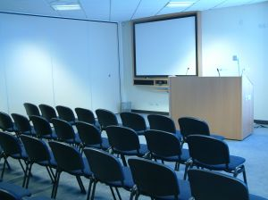
Participation and interest
Potential levels of participation and interest
Whilst an establishment may have the resources to host an event, two of the key factors that will be considered are:
Its ability to generate sufficient participation and interest
Its ability to generate sufficient profit
Notes:
Class Activity – Questions
When would an establishment hold a function or event for a ‘loss’?

Slide 57
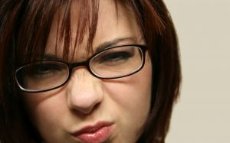
Level of competition
Competitive environment
Given each competitor will be trying to promote their ‘unique point of difference’ at times a hotel may not actively seek an event if:
Their venue is not appropriate
If a competitor is better suited to host the event
If a competitor is offering prices that do not provide suitable profit
Notes:
Class Activity – Questions
What would stop an establishment from NOT holding an event or function?

Slide 58

Timing and duration factors
Each organisation has limited resources which must be allocated and managed wisely in an effort to generate the greatest profits possible.
The concept of yield management is not unique to hotels.
Considerations on demand may include, but are not limited to:
Traditional peak periods
Public holidays
Other public events
Notes:
Class Activity – Questions
What is ‘yield management’?
How can ‘yield management’ be incorporated into event operations?

Slide 59

Talent of staff
Talent requirements
In order to successfully hold events an establishment must ensure the staff selected have the necessary knowledge and skills to undertake the roles and functions expected of them.
This knowledge and skill set may relate to:
Knowledge of the client and their needs
Cookery knowledge and skills
Service knowledge and skills
Product knowledge
Audio visual and IT skill sets
Notes:
Class Activity – Questions
What are examples of other specialised knowledge or skill sets required by staff working in events or functions?

Slide 60

Other factors
Other factors that need to be considered that impact on events and functions include:
Climate
Access
Marketing and promotional effort
The influence of media
Notes:
Class Activity – Questions
What other factors exist that have not been discussed to date?

Slide 61

Element 2:
Establish concept, theme and format of event
Notes:
Introduce topic.
Class Activity – General Discussion
Ask general questions:
What are common event concepts?
What are some themes that can be used at events?
What equipment or resources are required to have these concepts or themes?

Slide 62
Establish concept, theme and format of event
Performance Criteria for this Element are:
Meet both customer needs and expectations in accordance with organisation standards, policies and procedures and within acceptable time frames
Develop an overall event concept, theme and format which reflects key objectives agreed upon with customer/s and/or key stakeholders
Verify practicality and viability of concept, theme and format through a sound process of consultation and analysis
Notes:
Trainer identifies the Performance Criteria for this Element, as listed on the slide.

Slide 63
Establish concept, theme and format of event
Performance Criteria for this Element are:
Identify logistical requirements of overall concept, theme and format
Obtain relevant approval from customer/s and/or stakeholders prior to implementation
Notes:
Trainer identifies the Performance Criteria for this Element, as listed on the slide.

Slide 64

Organisation standards, policies and procedures
Follow guidelines when preparing information
Once all relevant details have been identified, it is now time for event organisers to prepare and present information to the client in a manner which:
Reflects their requirements
Contains all information in a clear and logical format
Meets their expectations
Follows all organisation standards, policies and procedures
Notes:
Class Activity – Questions
What needs to be taken into account when preparing information for the client?

Slide 65

Organisation standards, policies and procedures
Importance of organisation standards, policies and procedures
Before we explore how to prepare information to the client, it is important to identify the different types of organisation standards, policies and procedures that must be taken into account when preparing and operating events and functions.
Notes:
Class Activity – Questions
What are examples of organisation standards, policies and procedures that must be followed?

Slide 66

Organisation standards, policies and procedures
Organisational standard report forms
Event Brief
Contract
Booking Conditions
Confirmation Forms
Function Running Sheets
Catering Operational Plan
Catering Running Sheet
Invoices and Accounts
Customer Comment and Feedback Forms
Notes:
Class Activity – Review documents
Trainer to show these documents to audience and ask the following questions:
What is the purpose of each document?
What is contained within each document?
Who uses these reports?

Slide 67

Organisation standards, policies and procedures
Position descriptions
Position descriptions are often also known as ‘job descriptions’ and ‘duty statements’.
Identifies what each team member is responsible to undertake.
What is normally identified in these documents?
Notes:
Class Activity – Review documents
Trainer to show these documents to audience and ask the question in the slide.

Slide 68

Organisation standards, policies and procedures
Company policy documents
There are a number of other documents that are used to ensure activities comply with organisational requirements including:
Checklists
Performance Indicators
Policies
Procedures
SOPs
Notes:
Class Activity – Review documents
There are a number of other documents that are used to ensure activities comply with organisational requirements including:
Checklists – clearly indicates the tasks to be performed
Performance Indicators - the expected level of desired performance
Policies - a rule or guideline of expected performance
Procedures - a specified step by step guide how an activity is to be conducted
SOPs – Standard Operating Procedures.

Slide 69

Organisation standards, policies and procedures
Code of ethics
Codes of ethics are documents that explain to staff and help assist them in understanding the difference between 'right' and 'wrong' and in applying that understanding to their decisions.
Codes of business ethics
Codes of conduct for employees
Codes of professional practice
Notes:
Class Activity – Questions
What information is normally included in these three documents?

Slide 70

Organisation standards, policies and procedures
Performance standards
Performance standards describe:
How to present information to a client
How to confirm an event
How to set up for different types of functions
Notes:
Class Activity – Questions
What other types of performance standards exist for an event or function?

Slide 71

Organisation standards, policies and procedures
Performance standards
Standards of performance may be developed in relation to:
Productivity
Punctuality
Personal presentation
Level of accuracy in work performed
Adherence to procedures
Customer service standards
Team interaction
Response times/waiting times
Notes:
Class Activity – Questions
What are some specific and measurable standards for each of these points?

Slide 72

Organisation standards, policies and procedures
Job behaviour standards
As well as having performance standards for the various jobs, an organisation will also have job behaviour standards for employees
These behaviour standards, when met, ensure the individual behaves in a manner that also allows others to achieve their job standards
This allows the organisation to retain consistency throughout its operations
Notes:
Class Activity – Questions
What are examples of job behaviour standards?

Slide 73

Prepare event brief
What is an event brief?
An event brief is the template which contains all necessary information relating to a catered event or function
Notes:
Class Activity – Discussion
What is included inside an event brief?

Slide 74
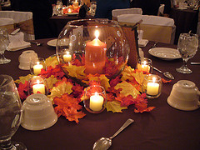
Contents of an event brief
Agreed event details
Identification of stakeholders
Allocation of responsibilities and setting of milestones and task completion dates
Type of function
Name, address, and contact number of client
Day, date and time of the function
Rooms and locations
Costings
Notes:
Class Activity – Discussion
Discuss these points.

Slide 75

Contents of an event brief
Billing instructions
Menu
Beverage arrangements
Sequence of service
Entertainment
Room set up
Type of service
Special requirements
Notes:
Class Activity – Discussion
Discuss these points.

Slide 76
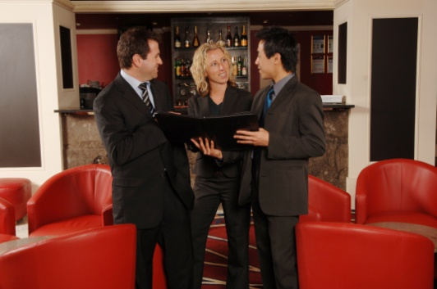
Verify practicality and viability of event concept
Verify event brief with internal stakeholders
Once an event brief has been prepared, it is important to clarify and seek approval from different stakeholders within the organisation, to ensure that what is going to be proposed to the client is:
Accurate
Possible to perform
Notes:
Class Activity – Questions
Who should be consulted?
Why?

Slide 77
Liaise with internal stakeholders
Types of assistance
Seeking advice or suggestions
Confirming information
Updating them about preparations and purchases
Undertaking logistical activities and arrangements
Assisting them to meet function requirements
Notes:
Class Activity – Discussion
Discuss points in the slide.

Slide 78
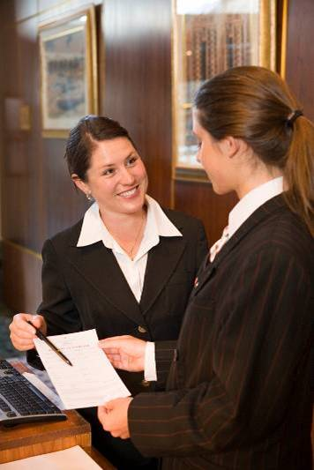
Liaise with internal stakeholders
Who might be involved?
Executive Chef
Beverage Manager
Maintenance Department
Executive Housekeeper
Catering and Conference Coordinator
Purchasing Manager
Front Office Manager
Security
Notes:
Class Activity – Questions
What specialist advice can these people provide?
How is it best to involve them?
Food requirements discussed with Executive Chef
Beverage requirements discussed with Beverage Manager
Technical requirements discussed with Maintenance Department or outside suppliers
Linen requirements discussed with housekeeping – outside suppliers may also be involved
Room decorations and floral arrangements discussed with housekeeping or outside suppliers
Facility set-up requirements discussed with Catering and Food and Beverage or functions coordinator.

Slide 79
Liaise with internal stakeholders
What input can these people make?
Their previous experience
Their specialist areas of expertise
Their individual knowledge of:
The venue
What it can do
What it has to offer
What it has done successfully and unsuccessfully in the past
Notes:
Class Activity – Stories
Trainer and audience to share stories about assistance that was provided by other departments when preparing functions.

Slide 80

Identify logistical requirements
Identify event logistical requirements
There are a number of logistical requirements that need to be determined when preparing for an event or function.
What are examples of event logistical requirements?
Notes:
Class Activity – Discussion
Discuss the question in this slide.

Slide 81

Identify potential venues and sites
Venue/location considerations
Location in relation to office, public transport or potential audience
Indoor/outdoor location
Venue quality or brand
Space
Reputation
Aesthetic appeal
Accommodation
Venue facilities and services
Cost
Notes:
Class Activity – Discussion
Discuss considerations associated with each point.

Slide 82

Identify potential venues and sites
Potential event locations
Hotels
Resorts
Restaurants
Homes for private functions
Schools, university and other educational providers
Meetings rooms
Banquet rooms
Notes:
Class Activity – Discussion
What types of functions would be held in these locations?

Slide 83

Identify potential venues and sites
Potential event locations
Convention halls
Exhibition centres
Reception wedding centres
Nature areas including open water, zoos, parks, wineries
Notes:
Class Activity – Discussion
What types of functions would be held in these locations?

Slide 84
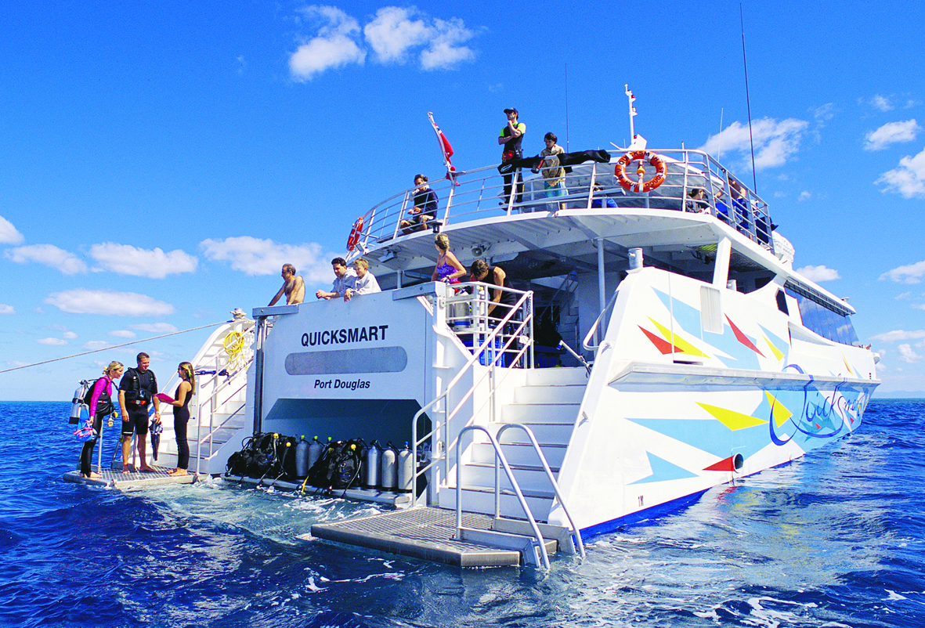
Identify potential venues and sites
Potential event locations
Transportation vehicles – including planes, yachts, cars, buses
Festivals
Sporting venues
Government buildings and civic centres
Museums
Notes:
Class Activity – Discussion
What types of functions would be held in these locations?

Slide 85
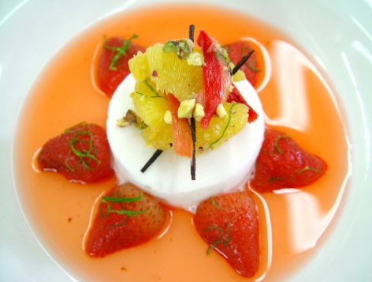
Catering
Catering refers to the provision of food and beverages for an event
Most events will have some element of food or beverage to it, either as the key component, as in the case of celebratory dinners and weddings, or maybe a secondary part such as a working lunch during a conference
Notes:
Class Activity – Questions
What are examples of catering that is provided as part of an event?

Slide 86
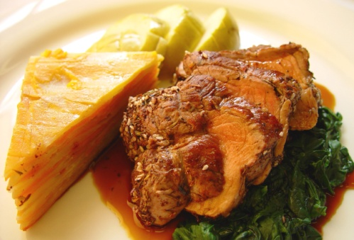
Factors impacting catering
Types of event factors that impact on catering
Available budget
Dates and time of function
Numbers of participants
Speed of service required due to timing demands on activities within an event
Types of food required
Service styles required
Cuisines preferred
Notes:
Class Activity – Questions
How will these factors impact on catering?

Slide 87
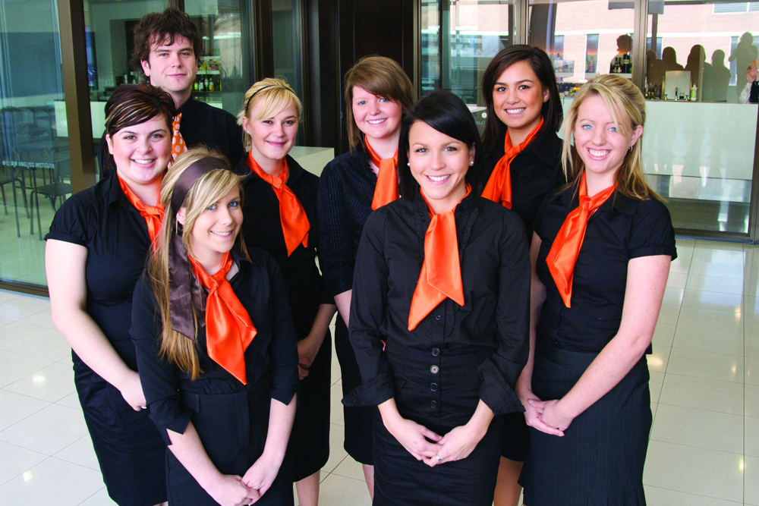
Factors impacting catering
Types of event factors that impact on catering
Location of event
Seasonal influences
Nature of event
Production and transport issues
General logistics
Staffing
Pre- and post-function activities
Notes:
Class Activity – Questions
How will these factors impact on catering?

Slide 88
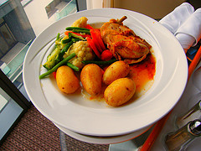
Event menu options
Menu considerations
Styles of functions
Styles of service required
Timing of functions
Providing a variety of price points
Having inclusive and non-inclusive menus
Notes:
Class Activity – General Questions
How can hotels provide a variety of price points?
What is the difference between inclusive and non-inclusive menus?

Slide 89

Types of food and beverage menus
The types and styles of food and beverage menus will vary greatly depending on:
Size and style of the venue
Type of function
Available budget
Client preferences
Nature of the function
Various timing factors
Notes:
Class Activity – General Discussion
Think about a range of different functions
What types of food and beverage would be appropriate?

Slide 90

Staffing
One of the key requirements when planning for a function is to ensure that you are adequately staffed for the event
Notes:
Class Activity – Questions
What factors need to be considered when considering staff needs for any particular event or function?

Slide 91
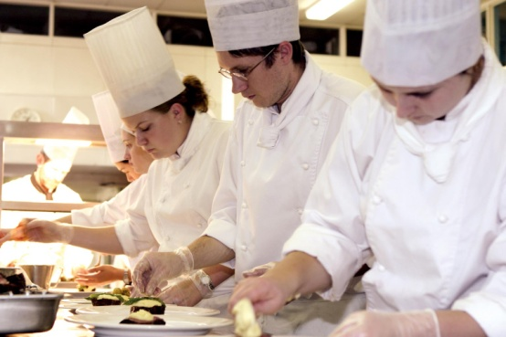
Staffing
Impacts on staffing
The amount and type of staff required to service a function will greatly depend on the:
Type of function
Service requirements
Numbers attending
Level of service required
Host of associated miscellaneous details
Notes:
Class Activity – Discussion
Explain how these points impact on rostering.

Slide 92
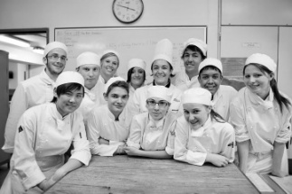
Staffing
Calculating staff numbers
Determining how many staff are needed or can be afforded for a function is based on a number of factors.
The following slides provide an overview of staffing needs for different function types.
What are these factors?
Notes:
Class Activity – Discussion
Get the audience to think of factors that will influence staff numbers.

Slide 93

Staffing
Calculating staff numbers
Breakfast Function – Self-service – Continental Menu
Staff to set up and service the buffet
Staff to greet and seat customers
Waiting staff to clear away unwanted crockery, cutlery and glassware
Staff to clean up function and set for lunch
Notes:
Class Activity – Discussion
Explain how would you staff this type of function.

Slide 94

Staffing
Calculating staff numbers
Cocktail Party – Informal Function – Stand up
Staff to set up function area
Bar staff to set up and run the bar
Waiting staff to carry platters of food
Staff to clean up the area after function
Notes:
Class Activity – Discussion
Explain how would you staff this type of function.

Slide 95

Staffing
Calculating staff numbers
Formal dinner party
Staff to set up function area
Bar staff to set up and run the bar
Waiting staff to provide semi-silver service to guests
Staff to clean up the area after function
Security staff
Notes:
Class Activity – Discussion
Explain how would you staff this type of function.

Slide 96

Staffing
Calculating staff numbers
General party
Staff to assist with decorations
Bar staff to set up and run the bar
Staff to coordinate and play music (DJ)
Staff to carry platters of food
Security staff
Notes:
Class Activity – Discussion
Explain how would you staff this type of function.

Slide 97
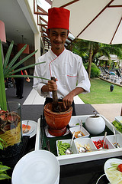
Staffing
Productivity standards
Every job has standards of performance that are required to be met by the employee undertaking that job
‘Expected levels of output’
Notes:
Class Activity – Discussion
Why is it important to have productivity standards?
Where do these come from?

Slide 98
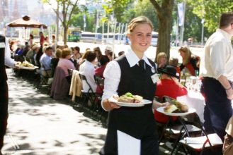
Staffing
Productivity standards
Performance standards are targets including:
Food waiters may be expected to serve X number of people
One bartender is used to serve X number of customers
Notes:
Class Activity – Discussion
What are different productivity standards for a variety of service styles?

Slide 99

Staffing
Budget
Rosters of functions need to consider relevant staff budgets
The cost of employing someone does not just mean their wages, but also includes many other costs
Notes:
Class Activity – Questions
What are other costs that need to be taken into account?

Slide 100

Staffing
Allocating the right mix of staff
When rostering staff it is essential to use the available skill sets and competencies of available staff to match the type of function
Staff should complement each other and provide a balanced service
Notes:
Class Activity – Questions
What can you do to get the right mix?

Slide 101
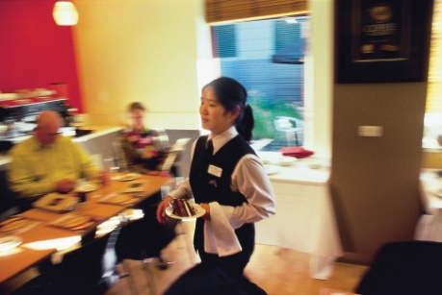
Staffing
Factors influencing the mix of staff
The mix of:
Experienced staff and new staff
Permanent and casually employed staff
Males to females
Skilled employees to semi-skilled employees
Language skills
Notes:
Class Activity – Questions
Why are these mixes important?
What benefits does each type of staff member identified in this slide bring to a function?

Slide 102

Stock
Types of stock
Specific types/brands of wine or other beverages
Specific food items from a specialist supplier
Specific linen items – for example a certain colour of table cloths and napkins
Specific furniture items
Notes:
Class Activity – Discussion
Discuss the different types of stock.

Slide 103

Furniture
This can include:
Tables and Chairs
Surrounding furniture
Stage
Signage
Aesthetics
Notes:
Class Activity – Discussion
Discuss the different types of furniture.
Tables and Chairs – for registration areas, speakers and guests
Surrounding furniture – including catering tables, chairs, coat racks, luggage storage
Stage – including lectern
Signage – to be displayed in the room itself, in front of the meeting room and the entrance of the building, including suitable directions
Aesthetics – flowers, plants, music lighting and temperature.

Slide 104
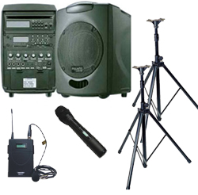
Equipment and stationary
Types of equipment and stationery
What types of equipment and stationery are commonly used for events or functions?
Notes:
Class Activity – Discussion
Discuss the different types of equipment and stationery commonly used for events or functions.

Slide 105
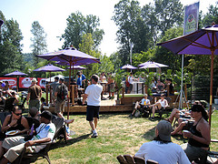
Outdoor event considerations
Outdoor event considerations
Food, beverage or alcohol
Tables, chairs, stage, grounds keeping, toilets etc
Tent, sheltered or enclosed spaces
Sound and lighting systems
Merchandise sales
Types of customers
Security
Notes:
Class Activity – Discussion
How will these affect infrastructure needs?

Slide 106
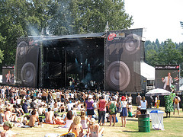
Outdoor event considerations
Outdoor event considerations
Transportation, traffic and parking
Entertainment
Ticket sales
Weather back up plans
Permits or special licenses
Local council restrictions
Notes:
Class Activity – Discussion
How will these affect infrastructure needs?

Slide 107
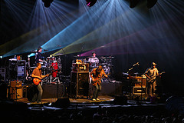
Outdoor event considerations
Types of infrastructure requirements
Power and water supply
Food and beverage equipment
Tables, chairs and related items
Environmental control
Toilets
Emergency services
Notes:
Class Activity – Discussion
Discuss these infrastructure needs.

Slide 108
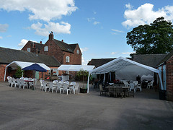
Outdoor event considerations
Types of infrastructure requirements
Car and coach parking
Disabled access
Signage
Waste management
Animals and insects
Weather considerations
Entertainment infrastructure
Notes:
Class Activity – Discussion
Discuss these infrastructure needs.

Slide 109

Provide proposal to client
All potential clients will need to be supplied with a proposal for their function before they commit to booking it and paying a deposit.
What should be included in a proposal?
Notes:
Class Activity – Questions
Discuss question in the slide and list items.

Slide 110

Provide proposal to client
Factors to take into account when developing a costing
Follow house policies
Make sure everything is charged for
Only include services and products the client has requested
Double-check your figures
Notes:
Class Activity – Discussing points to consider when preparing a proposal
Discuss steps associated with each factor.

Slide 111

Provide proposal to client
Factors to take into account when developing a costing
Identify and explain every charge
Observe promises made
Verify with management
Present the quotation in person
Notes:
Class Activity – Discussing points to consider when preparing a proposal
Discuss steps associated with each factor.

Slide 112

Element 3:
Prepare a concept plan
Notes:
Introduce topic.
Class Activity – General Discussion
Ask general questions:
What information is sent in a proposal?
How can you get agreement from the client?
What information needs to be placed into a contract?

Slide 113
Prepare a concept plan
Performance Criteria for this Element are:
Document theme and operational context of the event or function
Document elements of the total concept agreed to by customer/s and/or stakeholders
Gain written agreement from customer/s and/or stakeholders
Notes:
Trainer identifies the Performance Criteria for this Element, as listed on the slide.

Slide 114

Prepare proposal
Preparing proposal
Once all the event details have been internally confirmed and verified, it is now time to prepare and send the proposal.
What information needs to be included in a proposal?
Notes:
Class Activity – Questions
Discuss the question in the slide.

Slide 115

Prepare proposal
Inclusions in a proposal
In summary an event proposal should include:
Details of all catering proposed – including menus, drinks, timing, service times
Costs
Options available within designated budget parameters
Overview of production, transportation and service of food and beverages
Staff numbers
Reference to previous events that have been catered for on the same/similar scale
Notes:
Class Activity – Questions
Discuss these inclusions.

Slide 116

Follow up proposal
Within 24 hours of sending out a proposal a follow up call is required. This is used to determine the following:
If they received the proposal
If you can be of further assistance
If you would like to confirm the booking
Explain Method Of Payment
Notes:
Class Activity – Questions
What is the best way to follow up?

Slide 117

Document elements of the total concept
Once the proposal has been sent, normally there are three other documents that need to be prepared:
Event Management Plan
Function Running Sheet
Event Contract
Notes:
Class Activity – Discussion
What should be included in each of these documents?

Slide 118

Event management plan
Event management plan
This plan takes into consideration all possible scenarios and activities that need to either be planned or addressed
Notes:
Class Activity – Discussion
What should be included in an event management plan?

Slide 119

Event management plan
Inclusions in an event management plan
Staffing requirements
Security
Management of external contractors
Running sheets
Briefing papers
Staging elements or requirements
Notes:
Class Activity – Discussion
Discuss these inclusions
What needs to be considered or actioned in relation to each point?

Slide 120

Event management plan
Inclusions in an event management plan
Catering arrangements
Liaison with stakeholders, dignitaries, delegates and guests, media, sponsors
Guest/delegate management on arrival, during the event and on departure
Risk management
Emergency management
Performance standards and guidelines
Notes:
Class Activity – Discussion
Discuss these inclusions
What needs to be considered or actioned in relation to each point?

Slide 121
Event management plan
Inclusions in an event management plan
Traffic management
Specification of control, command and communication structures
Scopes of responsibility, identification of key contact details for event managers
Use of technology
Timing and co-ordination of services, facilities
Contingency plans
Notes:
Class Activity – Discussion
Discuss these inclusions
What needs to be considered or actioned in relation to each point?

Slide 122

Function sheets
A function sheet, sometimes also known as an ‘event order’ or ‘function order’, is an internal communication form developed to suit each venue’s needs that sets out the details of a function
What information is included in a Function Sheet?
Notes:
Class Activity – Questions
Ask the question in the slide.

Slide 123

Function sheets
Contents of a function sheet
Type of function
Name, address, and contact number of client
Day, date and time of the function
Rooms and locations
Billing instructions
Menu
Notes:
Class Activity – Discussion and Questions
Discuss points in the slide. What information would you like to know under each point?
Type of function – wedding, launch of product, ball
Name, address, and contact number of client
Day, date and time of the function
Rooms and locations where the function will be held
Billing instructions – who gets the bill, their address
Menu – break-down course-by-course of the agreed dishes including specification of ‘on arrival’ food, morning and afternoon teas.

Slide 124
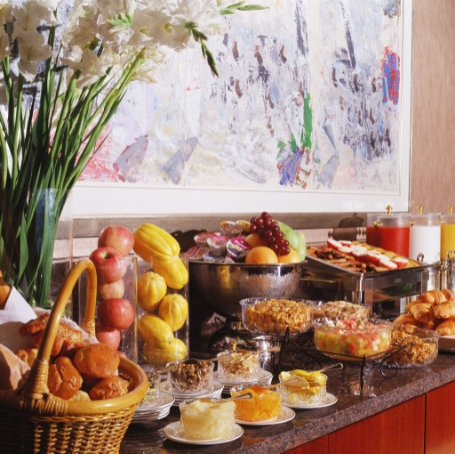
Function sheets
Contents of a function sheet
Beverage arrangements
Sequence of service
Entertainment
Room set up
Type of service
Special requirements
Notes:
Class Activity – Discussion and Questions
Discuss points in the slide. What information would you like to know under each point?
Beverage arrangements – description and quantities of beverages to be provided
Sequence of service – covering timing of service, and details of when speeches and presentations will occur
Entertainment – details of bands and the order of ceremony.
Room set up – number of tables, floor plan, decorations, table set-ups including cutlery, crockery and table accoutrements
Type of service – plated, tray, buffet, silver service, finger food
Special requirements – commonly relating to technology requirements such as microphone, DVD facilities, data projector, sound and lighting.

Slide 125

Event contract
Once the event details have been verbally confirmed with the customer, standard practice requires:
A written agreement to be drawn up
Is signed by all parties involved
Notes:
Class Activity – Questions
What information should be included in the Event Contract?

Slide 126
Event contract
Contents of a Contract
Full contact details of the client
Dates and times of the function
Date for notification of final numbers
Type of function
Service style
Seating arrangements
Equipment
Notes:
Class Activity – Discuss points in a contract
Discuss each point and important aspects to be recorded in each point.

Slide 127

Event contract
Contents of a Contract
Location of the function, name of rooms and facilities to be used
Approximate numbers attending
Décor, displays and table decorations
Food to be served – including when, type, amount
Beverages to be served
Entertainment, activities and inclusions
Notes:
Class Activity – Discuss points in a contract
Discuss each point and important aspects to be recorded in each point.

Slide 128
Event contract
Contents of a Contract
Ancillary sales:
Accommodation by type, number and dates
Tours
In-house Services
Provision of a Master of Ceremonies (MC) or Host
Photographers
Notes:
Class Activity – Discuss points in a contract
Discuss each point and important aspects to be recorded in each point.

Slide 129
Event contract
Contents of a Contract
Services and facilities the venue has agreed to provide at no charge
Technology required
Access required by the client prior to the function
Products and services the client will be supplying
Involvement of third party suppliers
Total cost of function
Notes:
Class Activity – Discuss points in a contract
Discuss each point and important aspects to be recorded in each point.

Slide 130
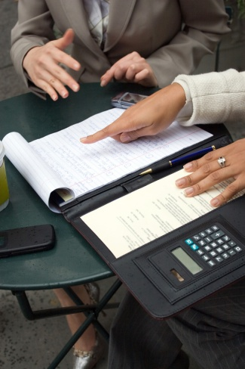
Event contract
Booking conditions
All venues will have specific booking conditions. These will usually appear on the website and form part of the standard function contract.
What information is normally included in booking conditions?
What are the benefits of having booking conditions?
Notes:
Class Activity – Questions
Ask questions in the slide.

Slide 131

Event contract
Contents of Booking Conditions
How long the client has to sign the function contract
Need for the client to provide information by a set date
Need for the client to advise the venue within a set time of any inaccuracies contained in the contract or running sheet
Ability of the client to make changes to expected numbers
Notes:
Class Activity – Discuss points in booking conditions
Discuss each point and important aspects to be recorded in each point.

Slide 132
Event contract
Contents of Booking Conditions
Payment requirements
Cancellation policy
Right of the venue to make changes
‘Force majeure’
Right of the venue to refuse certain activities or individuals
Notes:
Class Activity – Discuss points in booking conditions
Discuss each point and important aspects to be recorded in each point.

Slide 133
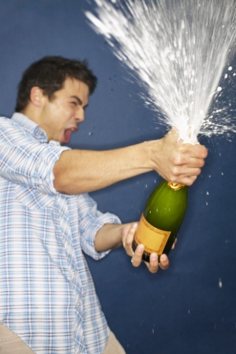
Event contract
Contents of Booking Conditions
Conditions that apply to decorating and using the venue
Loss and damage
Check-in and check-out times for accommodation rooms that are being included as part of the function
Notes:
Class Activity – Discuss points in booking conditions
Discuss each point and important aspects to be recorded in each point.

Slide 134
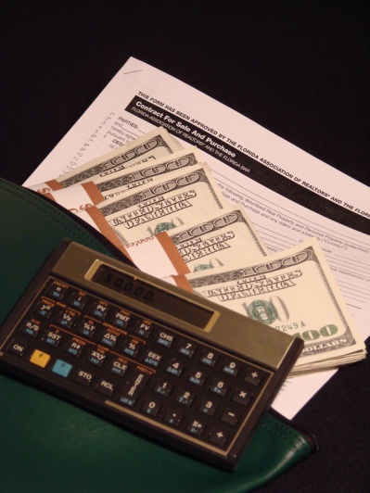
Obtaining deposit for function
It is standard industry practice to request a deposit when the final details of a function have been confirmed
No function exists until a deposit has been paid
Notes:
Class Activity – Questions
What is the standard practice for requesting a deposit?
How much deposit is normally required?

Slide 135
Obtaining deposit for function
Requesting the deposit
You may have blocked the required areas for an anticipated function, but it remains ‘tentative’ until a deposit has been secured and a contract signed.
How can you make a request for a deposit to be paid?
Notes:
Class Activity – Questions
Ask questions in the slide.

Slide 136

Obtaining deposit for function
Requesting the deposit
Methods include:
In writing
Over the phone
By email
In a face to face meeting
Notes:
Class Activity – Questions
Which is the most preferred method and why?

Slide 137

Obtaining deposit for function
Steps associated with handling deposits
Requesting deposit payment
Setting date for payment of deposit
Advising of payment options
Issuing receipt for deposit and confirmation
Recording payment of deposit on internal documentation
Advising customer of amount outstanding
Notes:
Class Activity – Discuss the actions associated with each step when handling deposits

Slide 138

Updated financial information
When the client pays a deposit for a function an account is usually opened for them at this stage.
Updating information can include:
Ensuring payment entries are recorded
Updating files when new payments are made
Notes:
Class Activity – Discuss the points in the slide

Slide 139

Preparing confirmations
A standard pro forma confirmation is sent to the client when they have signed the function contract and paid a deposit
This confirmation acknowledges the contract has been signed and that money has been paid and received
In addition a copy of Function Sheet is also sent
Notes:
Class Activity – Questions
What is the best way to send a confirmation and why?

Slide 140
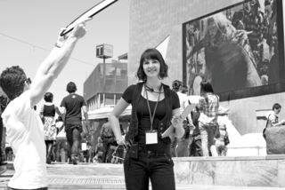
Finish:
Thank you!
Notes:
This is the conclusion of the subject.
Thank the audience and deliver assessments as required.

